Slide 1



Green University Of Bangladesh
DEPARTMENT OF COMPUTER SCIENCE AND ENGINEERING(CSE)
FACULTY OF SCIENCE AND ENGINEERING
Course Title: Statistics and Complex Variables
Course Code: MAT 201
Section: PC-221DG
Presented by :
Md. Mahim Hossain
ID: 221902082
Course Instructor :
Group-04
Shahidul Islam
Lecturer
Green University Of Bangladesh

Slide 2


A statistical analysis of road accidents in Bangladesh

Slide 3
The distribution of road accidents in different regions of Bangladesh was examined and any hotspots or areas with high accident rates were identified.
Table-01: Area wise Road Accident in Bangladesh Year (2009-2022).
Time Interval | No. of Accident | Area wise Accident | Area wise Accident | Area wise Accident | Area wise Accident
Time Interval | No. of Accident | Area wise Accident | Area wise Accident | Area wise Accident | Area wise Accident
Time Interval | No. of Accident | Dhaka | Sylhet | Khulna | Rangpur
Time Interval | No. of Accident | Dhaka | Sylhet | Khulna | Rangpur
2009 - 2010 | 3,456 | 1156 | 241 | 150 | 509
2009 - 2010 | 3,456 | 1156 | 241 | 150 | 509
2010 - 2011 | 3,632 | 1203 | 293 | 197 | 604
2010 - 2011 | 3,632 | 1203 | 293 | 197 | 604
2011 - 2012 | 3,810 | 1380 | 349 | 228 | 632
2011 - 2012 | 3,810 | 1380 | 349 | 228 | 632
2012 - 2013 | 3,996 | 1463 | 467 | 301 | 701
2012 - 2013 | 3,996 | 1463 | 467 | 301 | 701
2020 - 2021 | 1,809 | 804 | 105 | 99 | 212
2020 - 2021 | 1,809 | 804 | 105 | 99 | 212
2021 - 2022 | 1580 | 765 | 78 | 67 | 197
2021 - 2022 | 1580 | 765 | 78 | 67 | 197

Slide 4
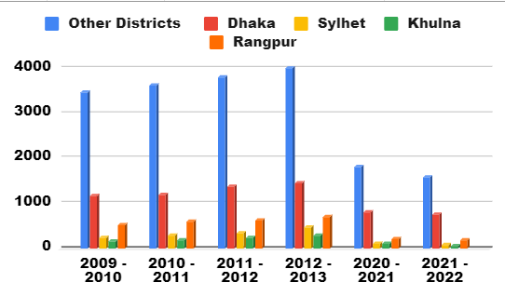
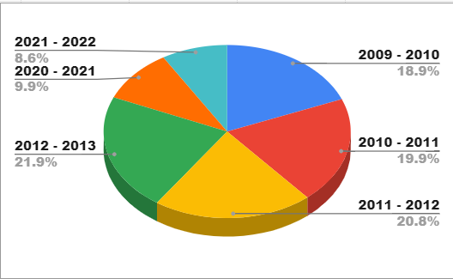
Table-02: Area wise Road Accident in Bangladesh Year (2009-2022).

Slide 5
Investigating the causes and contributing factors of road accidents in Bangladesh, such as reckless driving, poor road infrastructure, vehicle conditions or weather conditions.
Table-03: Cause wise Road Accident in Bangladesh Year (2009-2022)
Time Interval | No. of Accident | Causes of Accident | Causes of Accident | Causes of Accident | Causes of Accident
Time Interval | No. of Accident | Causes of Accident | Causes of Accident | Causes of Accident | Causes of Accident
Time Interval | No. of Accident | Speeding | Poor road condition | Young Driver | Bad weather
Time Interval | No. of Accident | Speeding | Poor road condition | Young Driver | Bad weather
2009 - 2010 | 3,456 | 1156 | 241 | 150 | 509
2009 - 2010 | 3,456 | 1156 | 241 | 150 | 509
2010 - 2011 | 3,632 | 1203 | 293 | 197 | 604
2010 - 2011 | 3,632 | 1203 | 293 | 197 | 604
2011 - 2012 | 3,810 | 1380 | 349 | 228 | 632
2011 - 2012 | 3,810 | 1380 | 349 | 228 | 632
2012 - 2013 | 3,996 | 1463 | 467 | 301 | 701
2012 - 2013 | 3,996 | 1463 | 467 | 301 | 701
2020 - 2021 | 1,809 | 804 | 105 | 99 | 212
2020 - 2021 | 1,809 | 804 | 105 | 99 | 212
2021 - 2022 | 1580 | 765 | 78 | 67 | 197
2021 - 2022 | 1580 | 765 | 78 | 67 | 197

Slide 6
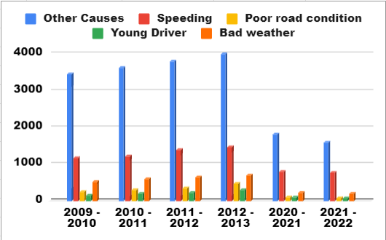
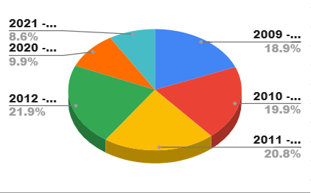
Table-04: Cause wise Road Accident rates in Bangladesh Year (2009-2022)

Slide 7
Thank You

